Slide 1
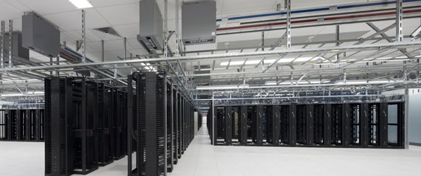
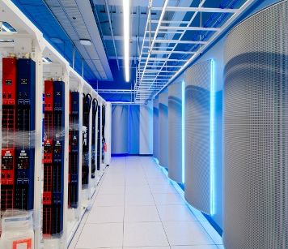
Cloud@eBay Overlay Networks
JC Martin – Cloud Architect (@jchmartin)

Slide 2
Any Application, Anywhere

Slide 3
Virtual Environments
Prod
QA
Exp.
Prod
QA
Exp.
Application
App
App
App
Application
App
App
App
Spare
spare
spare
spare
Global resource pool
Infra
Infra
Infra
Infra
Shared Infrastructure
Silos with custom design
Virtualized infrastructure

Slide 4
Class of Service
Production
DEV
Obligations | Restrictions | Capabilities
QA Approved Builds | No Login Access | Core DB access
Prod OS version | No Corp Access | 24/7 Incident Mgt
Monitoring | No QA Access | Site traffic Access
Obligations | Restrictions | Capabilities
Certified OS versions | Limited Prod Access | Full root
 | Limited QA Access
 | No site Traffic | Filtered Internet
External
Obligations | Restrictions | Capabilities
 | No Prod Access | Private DB
Certified OS Versions | No Corp Access | 24/7 Incident Mgt
Monitoring | No QA Access | Site traffic Access

Slide 5
Infrastructure designed for scale
Core
4 spines
Spine
(Nx10Gb)
N leaves
Leaves
(48x1Gb)
48 -> N “½ racks”
M servers
2x1Gb
Flat L3 (all switches are routers too)
Line rate from any server to any server (oversubscription = 48/40)
OSPF/ECMP to advertise routes

Slide 6
Isolation options : L2
Dedicated Network
VLAN Based
VLAN trunk
vlan 1
Prod
QA
vlan n
Production
QA
- physical network build out
- Fragmentation
- coarse grained isolation
+ Physical isolation
+ fool proof
- Limited scale (n = 4096) - Large fault domain (STP)
+ L2 isolation
+ somewhat soft Cabling

Slide 7
Isolation options: L3 with Security Groups
Security Groups or Virtual Firewall
+ no/minimal infrastructure requirement
+ good for user policies (ip tables)
- Difficult to combine provider policies and user policies
- Management of rules
- Impact of group membership modification
- Aggregation/summarization difficult/impossible

Slide 8
Isolation Options: Virtual L2 Networks
Virtual Networks using Software Defined Networks
Overlay 1
Other
Networks
Prod
QA
Overlay n
Cloud Fabric
+ L2 isolation
+ compatible with large scale networks
+ can be fully automated
+ firewall can be interposed between virtual networks
+ Can complement L3 isolation
+ large number of networks (n>4096)
- Tunnel overhead
- L2 size limited by # of tunnels and their mgt

Slide 9
SDN “levels”
Wizard
Physical Switches
Traffic Engineering
OSPF/ECMP,…
Virtual + Physical switches
Overlay Networks
Ninja
Virtual Switches
Overlay Networks
ARP + L2 protocols
Nerdy

Slide 10
Implementation using openstack + Nicira NVP
From 10.9.160.0/24 default->10.9.0.1 From 10.9.161.0/24 default->10.9.0.1
10.9.0.0/20 ->10.9.0.10
Standby Gateway
Tenant networks : 10.9.160.0/20
Eth1/vlan 1
Eth0/vlan 2
Corp
10.9.160.0/24
10.9.160.1
gtw-xxxx
N
gtw-xxxx
10.9.0.10
trunk
10.9.0.1
Internet
N
10.9.161.0/24
M
10.9.161.1
gtw-xxxx
QA
M
Eth1/vlan 1
vswitch
Eth0/vlan 2
vswitch
Nicira
Service
Nodes
Nicira
controllers
default->10.9.2.1
Nicira
Service
Nodes
Nicira
controllers
Active Gateway
vif
K
C
Hypervisor
S
A
Q
N:Nova-network+dnsmasq
C:Nova-compute
S:Nova-scheduler
M:Metadata
K:Ubuntu + KVM
A:Nova-api
Q:Quantum
vswitch
Infrastructure/Internal
Virtual network
Infrastructure/External

Slide 11
Openvswitch deployments
Virtualized
Bare Metal
Bare Metal
Bare Metal
vif1
vif0
vswitch
vswitch
eth0
eth0
vif0
eth0
eth0
Switch
vswitch
Future
QoS for drop precedence
Infrastructure (Physical)
Gateway
vif0
eth0
eth1
vswitch
External (Physical)

Slide 12
Good
Bad
Separation of concern : perimeter security done by netsec, Security groups done by cloud engineering
Separation of concern : Physical networks done by networking, overlay networks done by cloud engineering
Networks can be created on demand without physical switch modification.
Easily replicable pattern
Can be extended to L3 functions (Routing, NAT, …)
Capacity management of network / gateways not existent yet
No overlay networks for appliances (LB, FW, NAS, Bloc Storage) -> goes through gateways
Scale out requires bigger links out of the gateway, or more gateways
State in the gateways : HA implications
Visualization of overlay networks on top of physical networks
Implementation for Bare Metal servers requires switch based implementation of overlay networks.

Slide 13
Thanks
@jchmartin

